Slide 1
USA 3D COSTUME
SAMPLE

Slide 2
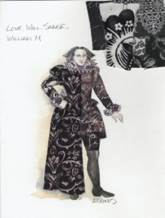
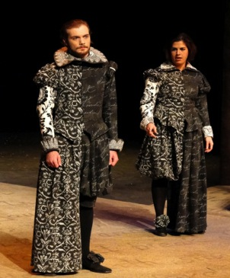
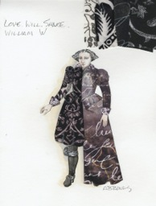
PLAY: LOVE WILL SHAKE COSTUME: Male and Female THEATRE: Robinson Theatre at University of Oregon Male Form- size 38 with legs Female Form- also size 38 with legs
ALEXANDRA BONDS

Slide 3
Biography
Alexandra B. Bonds is the Professor of Costume Design at the University of Oregon in the USA. Trained at Syracuse University and University of Denver, her designs have been featured in the United States Institute for Theatre Technology, Inc. Design Expo six times and included in the USITT-USA Prague Quadrennial exhibits in 1987, 1999, and 2007. Her costume designs were also selected for World Stage Design in 2009 and 2013. She has designed over one hundred productions nationally and internationally. As USITT Vice President for International Activities, she was the Commissioner for the USITT-USA national, student, and architecture exhibits to the PQ in 2003 and 2007, and International Liaison the exhibits for 2011. Alexandra is a leading expert in costumes for the Beijing opera and author of Beijing Opera Costumes, The Visual Communication of Character and Culture Through Clothing, published by the University of Hawaii Press in 2008. Her book is a definitive study of the historical context, symbolism, and practical techniques of dress in this traditional performance style. She has lectured at prestigious locations regionally and globally, including the Denver Art Museum, Los Angeles County Museum of Art, Wimbledon School of Art, and the Courtauld Institute in London, England.

Slide 4
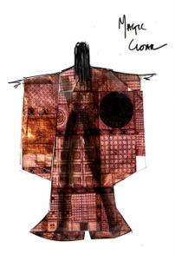
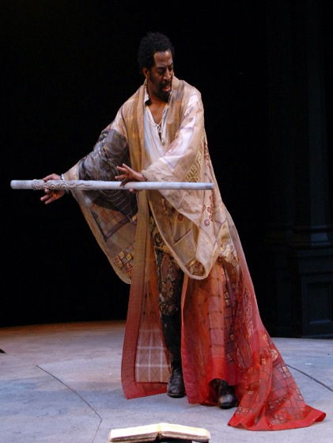
PLAY: THE TEMPEST COSTUME: Prospero Cape THEATRE: Oregon Shakespeare Festival Male Form 42-44 NOTE: Deb suggests that this costume will look best if hung on the wall like a Kimono. It is long and very detailed with dying and embroidery….more so than is visible in either image.
DEBORAH DRYDEN

Slide 5
BIO for DEBORAH M DRYDEN:
Deborah Dryden recently designed costumes for Robert Schenkkan’s “All The Way” on Broadway. She created the designs for part II ,“The Great Society” which premiered at the Oregon Shakespeare Festival in July, 2014.
Deborah holds the position of Resident Costume Designer Emerita for the Oregon Shakespeare Festival for which she designed for 34 seasons, retiring from that post in 2012.
She has designed costumes for theatres including: Arena Stage, Hong Kong Repertory Theatre, Kennedy Center, American Conservatory Theatre, Berkeley Repertory, Huntington Theatre, American Repertory Theatre, Arizona Theatre Company, Chicago Shakespeare Theatre, Alaska Repertory Theatre, Portland Center Stage, Portland Opera, Old Globe, Minnesota Opera, Denver Center Theatre, Alley Theatre, Milwaukee Repertory, Intiman Theatre, San Diego Opera,Seattle Repertory, La Jolla Playhouse and the Mark Taper Forum.
She is a Professor Emerita of Design at University of California, San Diego, where she taught for many years. Her special interest in interdisciplinary design training resulted in an Artist-in-Residence semester at the University of Wisconsin-Madison in 2010.
A career long passion for fabric modification and the textile arts led to the publication of the book“Fabric Painting and Dyeing for the Theatre”. Deborah continues to teach workshops and master classes in design and fabric dyeing and painting.
Exhibited work includes Prague Quadrennial of Scenography and “Curtain Call, Celebrating a Century of Women Designing for Live Performance”, NY Public Library of Performing Arts, Lincoln Center
Awards include the Michael Merritt Award for Design and Collaboration, USITT Distinguished Achievement Award, and the 2014 tdf/Irene Sharaff Lifetime Achievement Award.

Slide 6
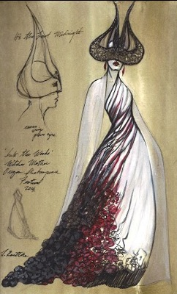
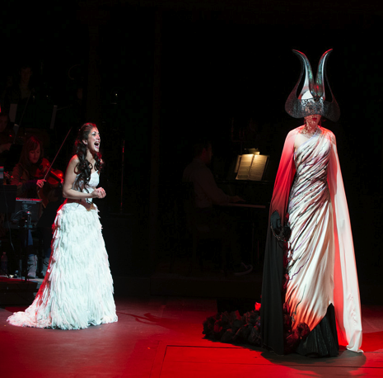
PLAY: INTO THE WOODS COSTUME: Witch’s Mother THEATRE: Oregon Shakespeare Festival Female Form: size 4 "the designer has no funds to mail the costume”
LINDA ROETHKE

Slide 7
Linda Roethke
Costume Designer
Off Broadway: Richard III (The Public Theater). Regional: Into the Woods, King Lear, As You Like It, Julius Caesar, All’s Well That Ends Well (Oregon Shakespeare Festival); The Geller Girls, Managing Maxine, The Underpants, Shadowlands (Alliance Theatre); The Game's Afoot (Cleveland Playhouse); Water by the Spoonful, The Dead, Orlando (Court Theatre); Stage Kiss, The Clean House (Goodman Theatre); Motherf**ker with the Hat, Dead Man’s Cell Phone, Intimate Apparel (Steppenwolf Theatre Company); Miss Saigon (The Paramount Theatre). Cincinnati Playhouse, Repertory Theatre of St. Louis, Actors Theatre of Louisville, Chicago Shakespeare Theater, Utah Shakespeare Festival, Connecticut Repertory Theatre, Arden Theatre Company, Center Stage, Maltz Jupiter Theatre, American Players Theatre. Other credits: Director of the MFA Design Program at Northwestern University, where she teaches costume design. Awards: Jeff Award (An Ideal Husband, Court Theatre); Suzi Bass nomination (The Underpants, Alliance Theatre); Connecticut Circle nomination (A Little Night Music, Connecticut Repertory Theatre. Education: MFA, University of Iowa.

